Slide 1
Preparing for the Boat Forces Physical Fitness Test
Timothy C. Gribbin, MEd, ATC, CSCS
Clinical Research Associate, HJF
In support of The Consortium for Health and Military Performance A DoD Center of Excellence
Department of Military & Emergency Medicine, School of Medicine Uniformed Services University of the Health Sciences
Henry M. Jackson for the Advancement of Military Medicine, Inc.

Slide 2
Disclosure Information
The opinions and assertions expressed herein are those of the author(s) and do not reflect the official policy or position of the Uniformed Services University or the Department of Defense.
The contents of this publication are the sole responsibility of the author(s) and do not necessarily reflect the views, opinions or policies of The Henry M. Jackson Foundation for the Advancement of Military Medicine, Inc. Mention of trade names, commercial products, or organizations does not imply endorsement by the U.S. Government.
The authors have no financial interests or relationships to disclose.

Slide 3
Objectives
Overview of the Boat Forces PFT
Describe training variables for PFT components
Example exercises and sample workouts
Describe Recruit Training Physical Training Program

Slide 4
What is the PFT?
Required for law enforcement and boat crew members
Performed during qual, recert, and semi-annually or when required by CO/OIC
Required for members not in compliance with weight or body fat standards

Slide 5
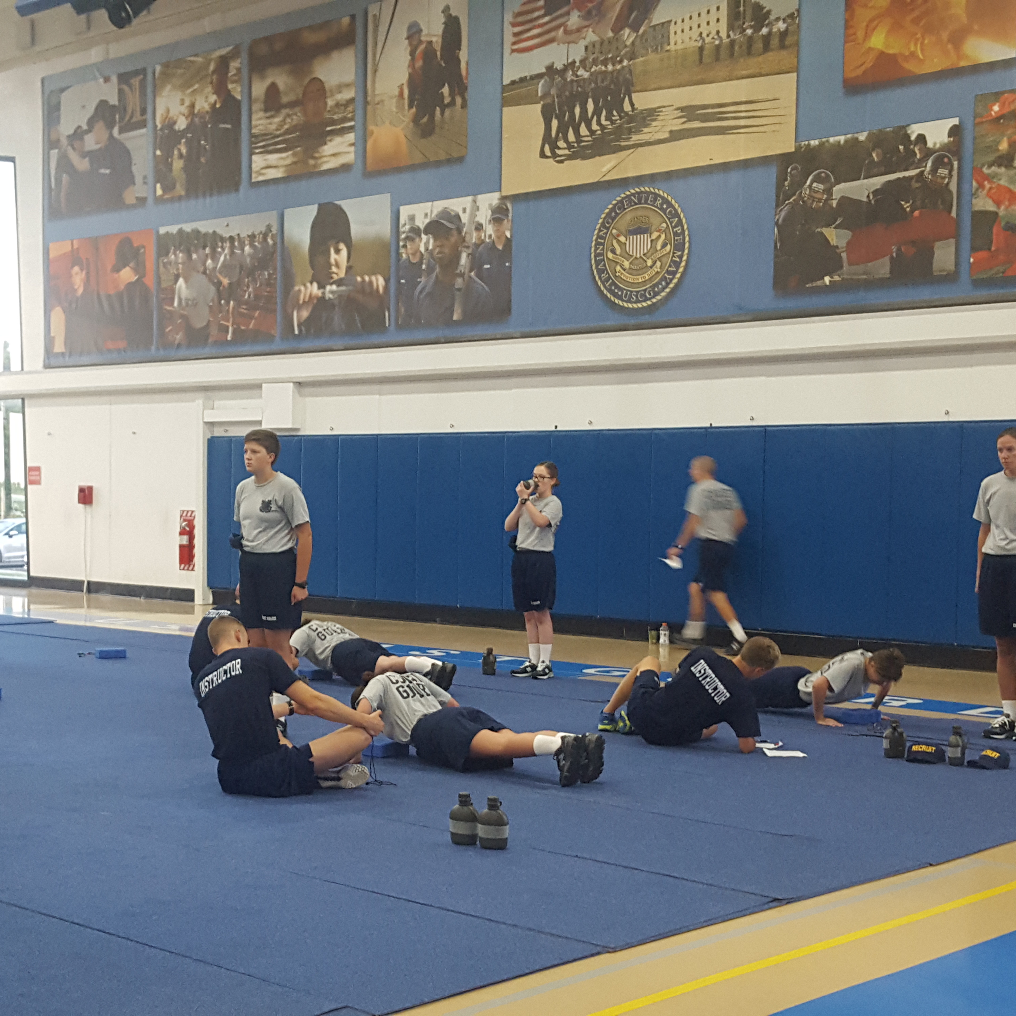
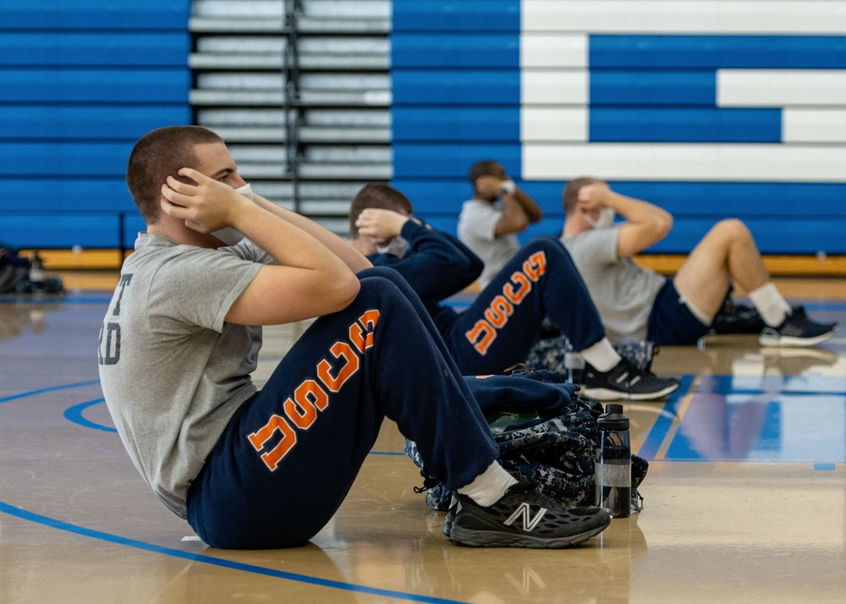
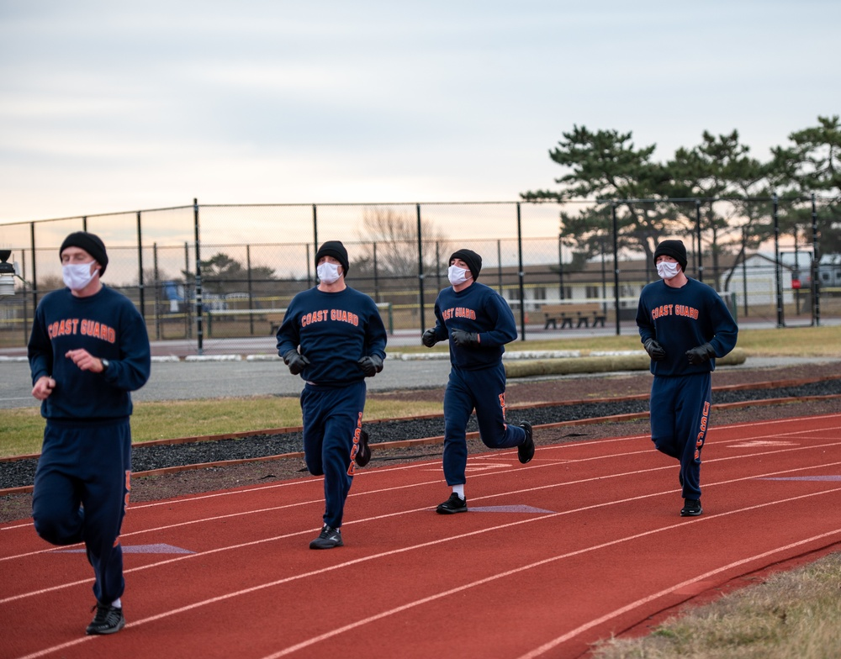
What is the PFT?
1-minute push-up
1-minute sit-up
1.5-mile run
12-minute swim alternative
Notes:
01.08.2021
Photo by Seaman Josalyn Brown
U.S. Coast Guard Training Center Cape May

Slide 6
PFT Standards
U.S. Coast Guard Boat Operations and Training (BOAT) Manual Volume II
COMDTINST M16114.33D February 2020

Slide 7
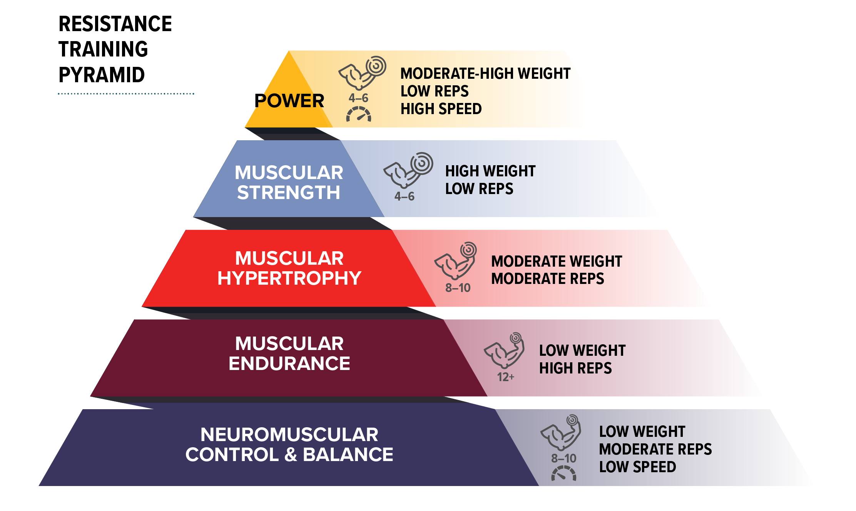
PFT Domains of Fitness
Aerobic endurance
Anaerobic endurance
Speed
Agility

Slide 8
Muscles Used

Slide 9
Variables in a PT Program
Frequency
How often
Intensity
How hard
Time
How long
Type
What you do
Volume
How much
Progression
How you overload

Slide 10
Resistance Training for Push-up Component
Frequency: 2–3 days per week
Intensity and volume
Training goal | Intensity (% 1RM) | Goal repetitions | Goal sets per muscle group | Rest duration
Strength Multi-joint exercises Single joint exercises | ≥85% 75–80% | ≤6 ≤6 | 2–6 2–6 | 2–5 minutes 5’ rest most appropriate for loads close to 1RM
Hypertrophy | 67–85% | 6–12 | 3–6 | 30–90 seconds
Muscular endurance | ≤67% | ≥12 | 2–3 | ≤30 seconds

Slide 11
Are you lifting at the right intensity?
What is 67% of your 1RM?.......What is your 1RM?
Options:
Test 1RM – requires time, equipment, supervision, knowledge
SWAG Estimate

Slide 12
SWAG Estimate for Pushups
Pushups are ~65% of your body weight
Amount lifted = body weight x 0.65
Barbell bench press amount lifted, or dumbbell bench press half of amount lifted
Aim for 12–15 reps. If too easy, increase the weight. The last 3 reps should be challenging
For other exercises: pick a weight, aim for 12–15 reps, adjust weight as necessary

Slide 13
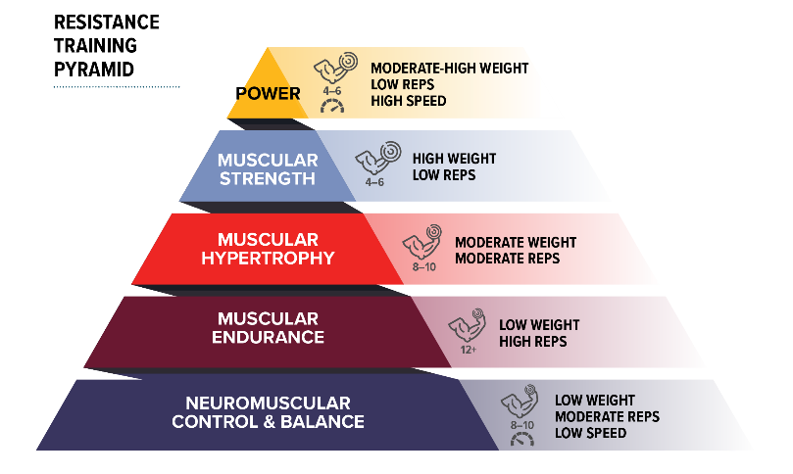
Resistance Training for Push-up Component
Progression
2-for-2 rule: Increase weight when perform 2 reps over goal in the last set, 2 workouts in a row
2-for-2 rule
Less trained | Upper Body | 2.5–5 lb
 | Lower Body | 5–10 lb
More trained | Upper Body | 5–10 lb
 | Lower Body | 10–15 lb
Can ↑
reps weekly

Slide 14
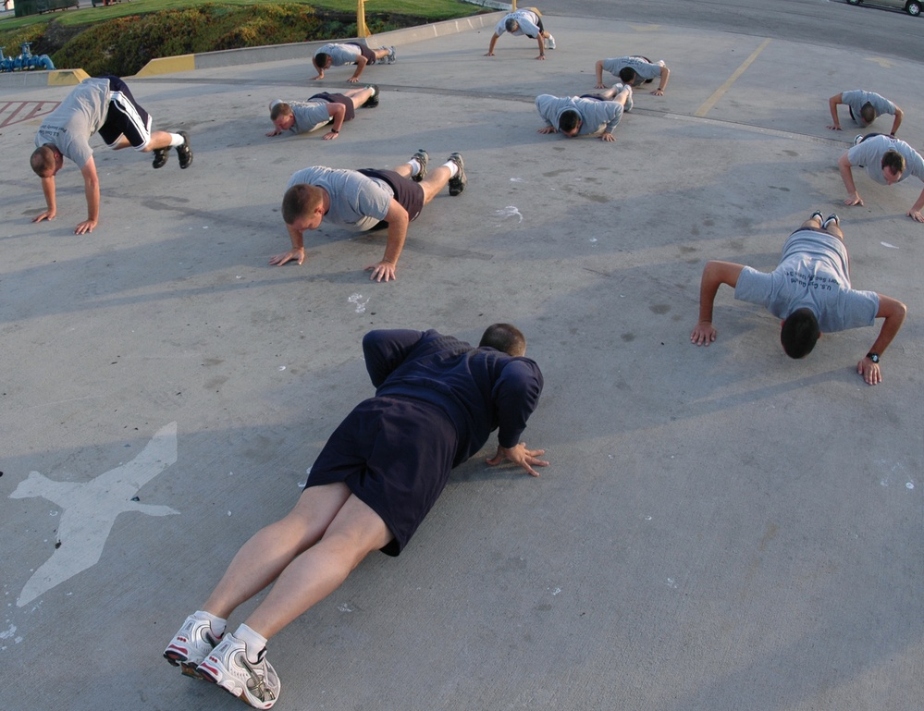
Resistance Training for Push-up Component
Time: Depends on training goal and program structure
Type:

Slide 15
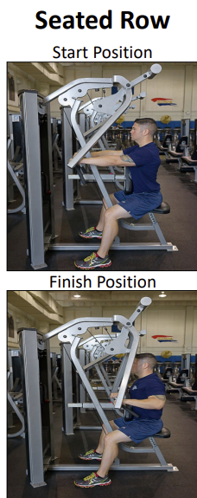
Resistance Training for Push-up Component
Don’t exclusively work the chest
Contributes to excessive head/shoulders forward posture
Incorporate upper back exercises

Slide 16
Sit-ups

Slide 17
Training for Sit-up Component
Test of core-muscle endurance
Excessive sit-up training can contribute to back pain
Tight, over-active hip flexors

Slide 18
Core for Sit-up Performance
Core strengthening exercises will improve sit-up performance as well as exclusive sit-up training
Can be incorporated as part of a regular PT program, and doesn’t need to be exclusively trained
Low intensity, high volume
Static holds for 15+ seconds, increase over time
12+ reps, increase over time

Slide 19
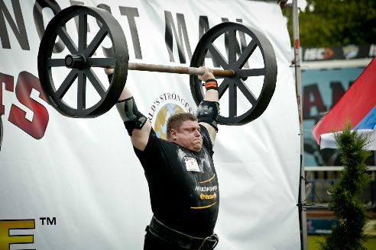
What is the “Core”
Myth
Fact

Slide 20
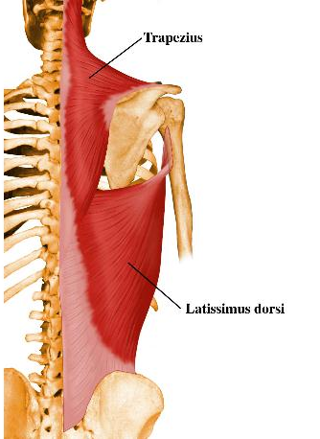
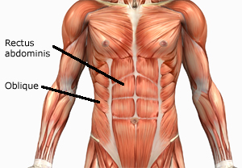
What is the “Core”
Not only gross movers
Rectus Abdominus, Back Extensors, etc.

Slide 21
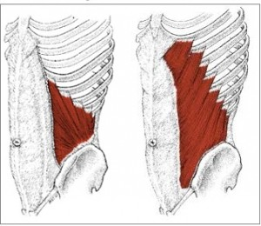
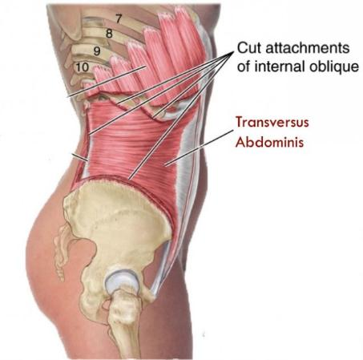
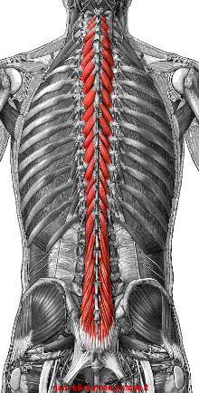
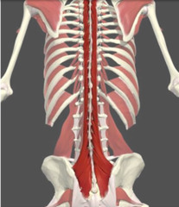
What is the “Core”
Primarily small stabilizing muscles
Transverse Rectus Abdominus, Internal and External Obliques, Multifidi

Slide 22
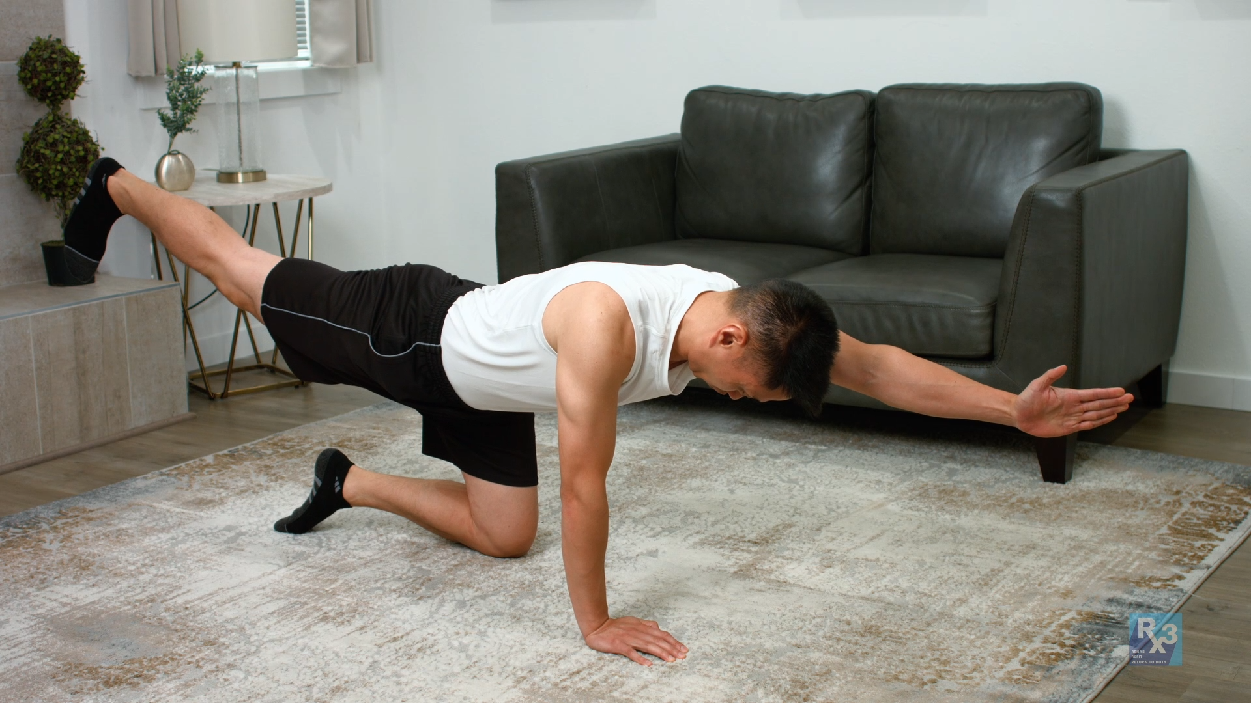
How to train the “Core”
Myth
Fact
50 sets of 1000 reps

Slide 23
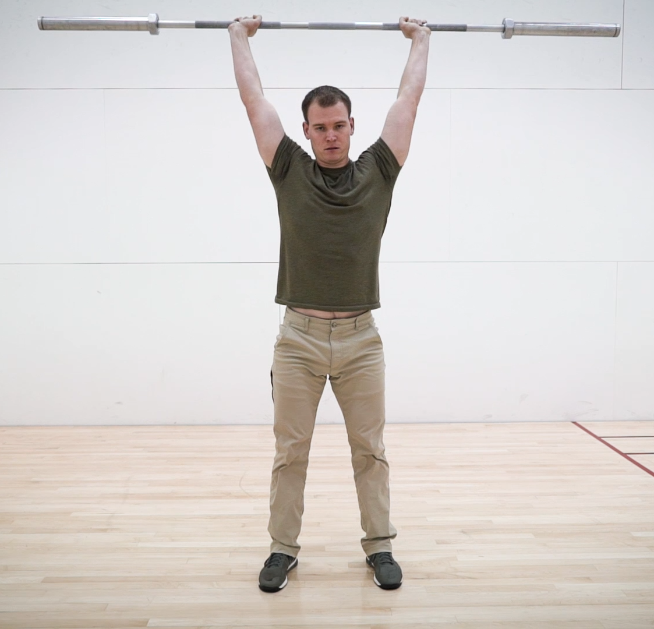
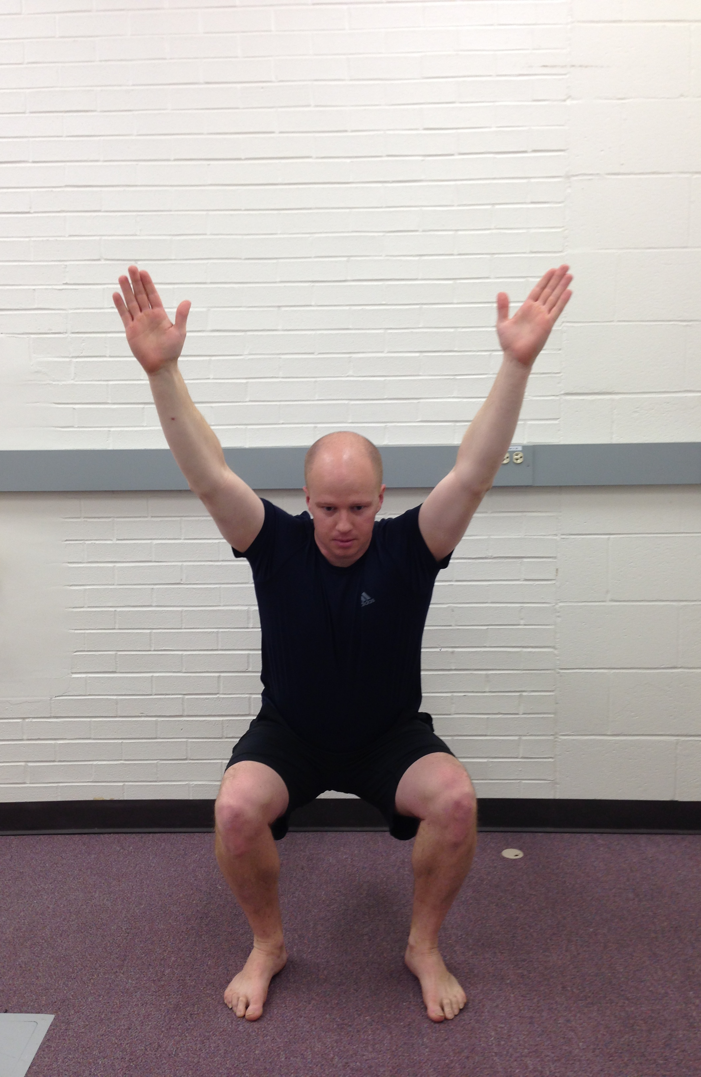
How do we strengthen the core?
The core is the foundation for movement
Start small and work your way up
Stationary
Limited movement
Dynamic exercises
Loaded exercises

Slide 24
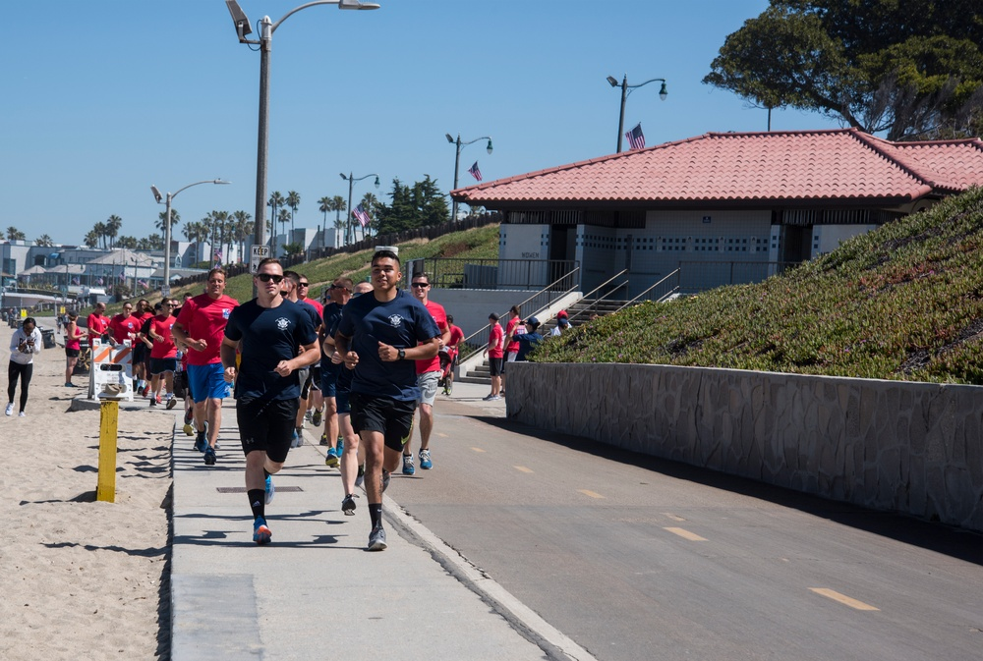
Aerobic Training

Slide 25
Aerobic Training
Rating | Intensity
6
7 | Very, very light
8
9 | Very light
10
11 | Fairly light
12
13 | Somewhat hard
14
15 | Hard
16
17 | Very hard
18
19 | Very, very hard
20
Frequency: 2–3 days per week
Intensity:
% Max HR
(220 – Age) OR (208 – 0.7*Age)
Moderate = 64–76%
Vigorous = 77–93%
RPE
Moderate = 12–14
Vigorous = 15–17

Slide 26
Aerobic Training
Training type | Description
Long, slow distance | High volume, consistent moderate intensity
Interval training | Alternates periods of vigorous intensity cardio for 3–5 minutes and active recovery for an equal period
Pace or tempo training | Consistent pace at higher intensity than LSD. Vigorous, but sub-maximal
Repeated sprints | 200 meters or shorter and less than 30 seconds in duration.
HIIT | Similar to interval training, but at maximal intensity for shorter bouts of time—usually about 30–90 seconds of work with 15–90 seconds of rest
Fartlek | Combination of LSD and pace/tempo training. Run at moderate intensity with short bursts of vigorous-intensity running

Slide 27
Aerobic Training
Training type | Frequency (per week) | Intensity | Time
Long, slow distance | 1–2 days | Moderate intensity | 30–120 minutes
Interval training | 1–2 days | Vigorous intensity, near maximal effort | 3–5 minutes (work:rest ratio of 1:1)
Pace or tempo training | 1–2 days | Vigorous intensity | 20–30 min
Repeated sprints | 1–2 days | Maximal intensity | 5–20 sprints, depending on distance and fitness
HIIT | 1 day | Maximal intensity | 30–90 seconds (work:rest ratio ranging from 2:1 to 1:1)
Fartlek | 1 day | Moderate to vigorous intensity | 20–60 minutes

Slide 28
Aerobic Training
Volume – Low if unfit
30 minutes of moderate-intensity LSD 2x/week is a good place to start
Walk or jog intervals for unfit people should have fairly low work:rest ratios (1:3–1:4) and progress to the recommended 1:1 over a period of a few weeks, with a total training day volume of 20–30 minutes

Slide 29
Aerobic Training
Progression
Cardio: 10% rule
Increase frequency, duration, or intensity a max of 10% each week
Some research is questioning this old guideline
Low volume, can increase >10%
High volume, <10%

Slide 30
Example Training Programs

Slide 31
Sample Schedule
Sunday | Off
Monday | Upper-body & core
Tuesday | LSD cardio
Wednesday | Lower-body & core
Thursday | Pace cardio, short to moderate distance
Friday | Total-body & core
Saturday | Off

Slide 32
Upper-body Exercises

Slide 33
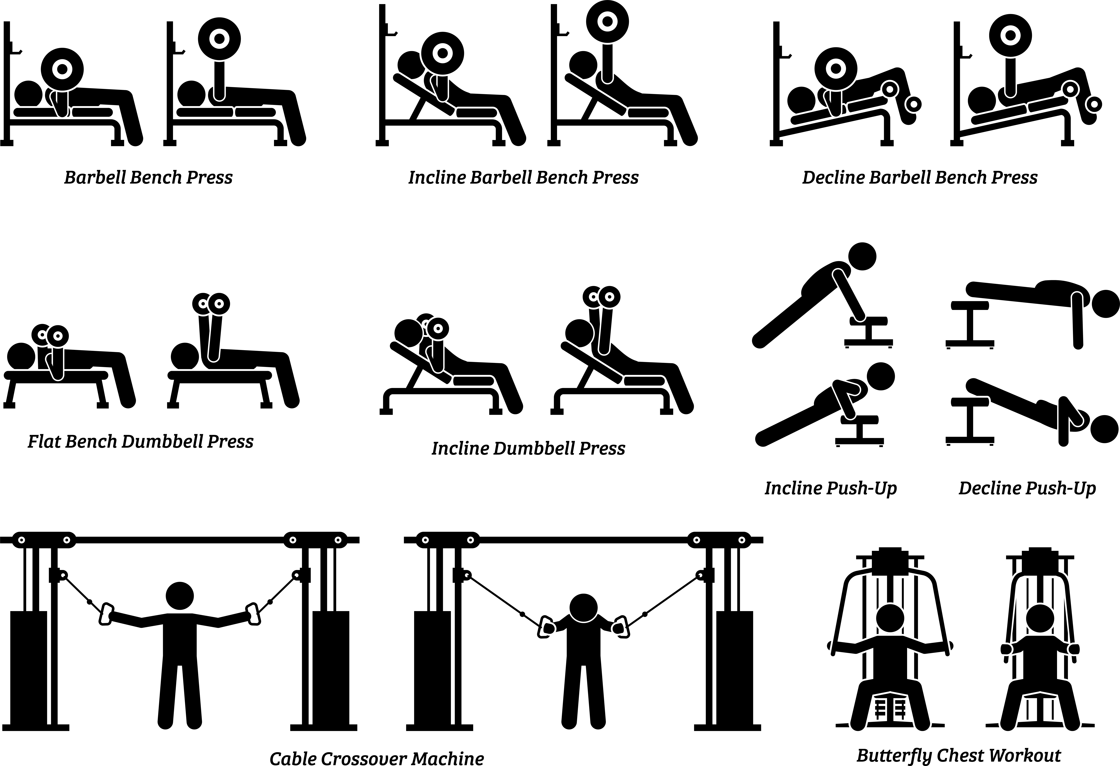
Upper body Exercises

Slide 34
Sample Upper-body workout
Muscle Group | Exercise | Sets x reps
Chest | Dumbbell press | 3 x 12
Back | Bent-over row | 3 x 12
Chest | Chest fly | 3 x 12
Back | Back fly | 3 x 12
Weight guidance: ≤67% of 1-rep max
Reps 10–12 are a challenge, but you can do them
2-for-2 rule to increase weight
OR start at 10 reps, increase 2 reps weekly until 16 reps. If unable to increase reps, stay at that level for another 2–3 weeks

Slide 35
Core Exercises

Slide 36
Sample Core-circuit Workout

Slide 37
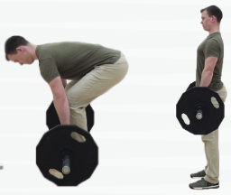
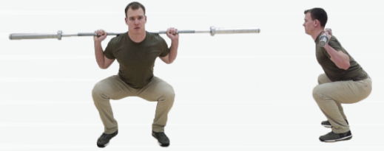
Lower-body Exercises

Slide 38
Sample Lower-body workout
Muscle Group | Exercise | Sets x reps
Glutes | Deadlift | 3 x 12
Quads | Weighted lunge | 3 x 12
Hamstrings | Romanian deadlift | 3 x 12
Quads | Lateral lunge | 3 x 12
Weight guidance: ≤67% of 1-rep max
Reps 10–12 are a challenge, but you can do them
2-for-2 rule to increase weight
OR start at 10 reps, increase 2 reps weekly until 16 reps. If unable to increase reps, stay at that level for another 2–3 weeks

Slide 39
Sample Cardio Program

Slide 40
Sample Cardio Program

Slide 41
Summary
Boat Forces PFT measures both cardiorespiratory and muscular endurance
Both components of fitness take time to improve
Train both chest and back for push-ups
Train core for sit-ups
Don’t exclusively take the PFT as a training program

Slide 42
Thanks for your feedback!
timothy.gribbin.ctr@usuhs.edu
Notes:
Poll Title: Do not modify the notes in this section to avoid tampering with the Poll Everywhere activity. More info at polleverywhere.com/support Post-brief feedback https://www.polleverywhere.com/surveys/zXW96bhVkxV9jFJuCI54s?flow=Default&onscreen=persist

Slide 43
CHAMP/HPRC
Educational Resources
Select Initiatives
Outreach
Present & Train
Newsletter
Social Media
Sign Up Today
Notes:
LAUREN

Slide 44
Educational Resources
Select Initiatives
Outreach
Present & Train
CHAMP/HPRC
HPRConline
Notes:
LAUREN

Slide 45
For Further Information
Session Feedback
Please contact: timothy.gribbin.ctr@usuhs.edu
Web Resources:
https://www.hprc-online.org/
https://www.opss.org/
All photos were used under a license or with permission. Slides reviewed by Dr. Lauren Messina (HJF), Assistant Professor, CAHS, USU

